Slide 1
SOFTWARE DEVELOPMENT
CAPSTONE PROJECT
Dare to Dream
Course code:
SE133
Submission Date:
10.06.24

Slide 2
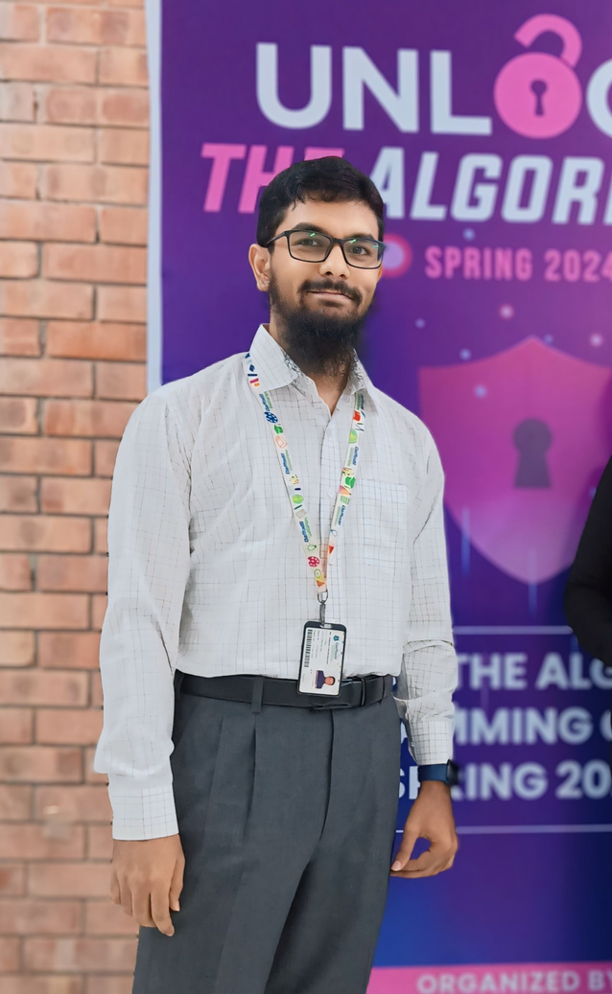
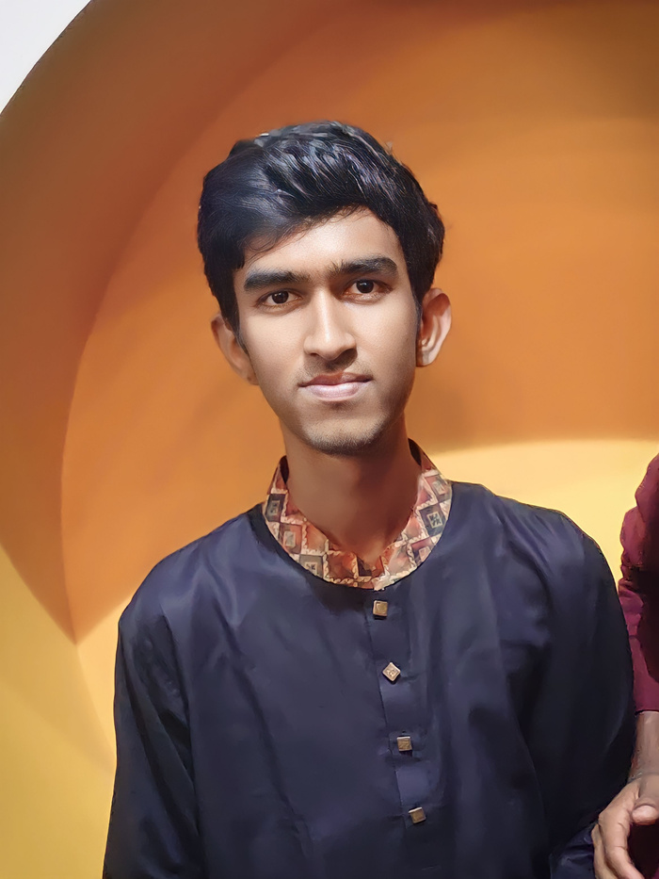

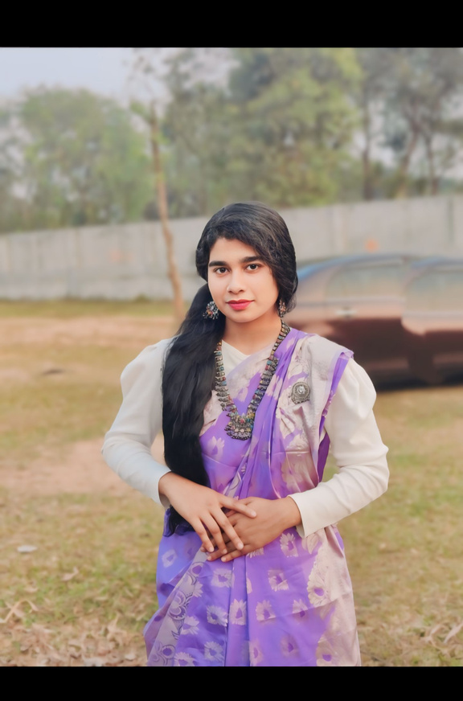
OUR TEAM:
Sharmin Akter Ratna 0242310005341052
Md Alif Khan
232-35-740
Romana Akter Romky
0242310005341073
Jannatul Ferdus Asha
0242310005341064

Slide 3
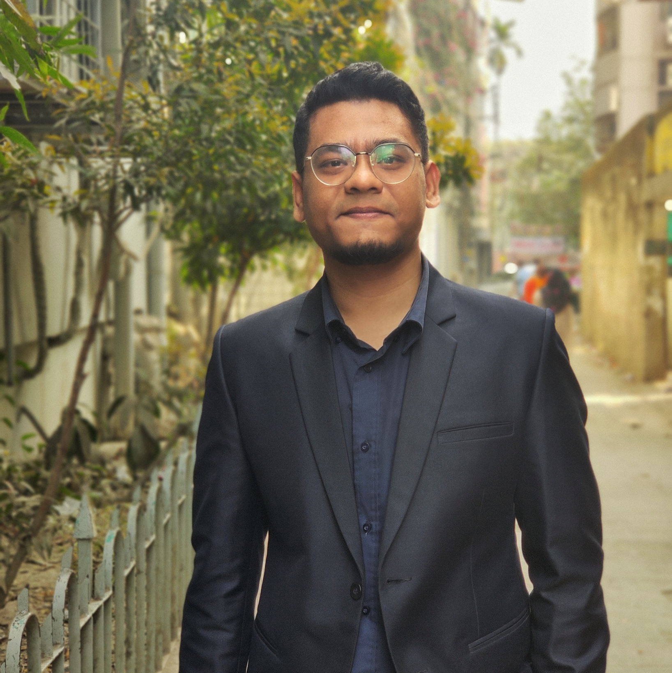

INSTRUCTOR
Name: Abdul Hye Zebon
Designation: Lecturer
Depertment: Depertment
of Software Engineering

Slide 4

PRESENTATION TOPICS
Bus Ticket
Reseservation System

Slide 5
Briefing
Overview
System Demonstration
Function Analysis

Slide 6
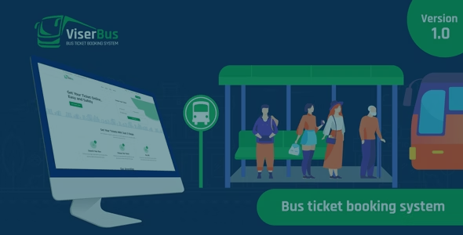
Inrtoduction
The Bus Ticket Reservation System code. The goal of this system is to provide functionality for administrators to install bus information, for users to register, book, and cancel tickets, and to access customer service and provide feedback.

Slide 7
The Bus Ticket Reservation System offers comprehensive features for both administrators and users:
For Administrators:
Manage bus information (routes, schedules, fares).
Oversee bookings and seat availability.
For Users:
Register and manage accounts.
Book and cancel tickets.
Access customer service.
Provide feedback on services.
This system ensures efficient bus reservation management and a seamless user experience.
System Demonstration

Slide 8
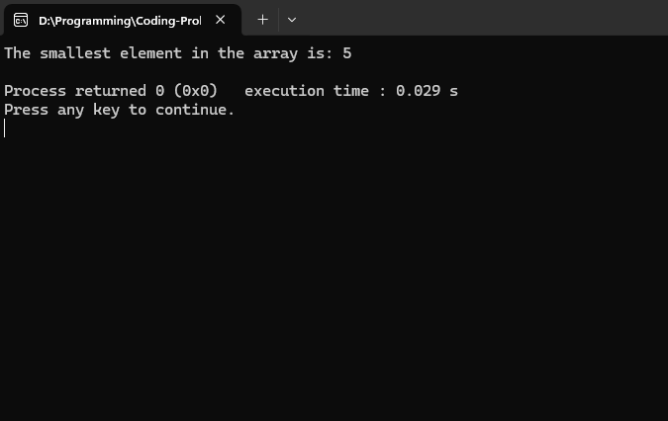
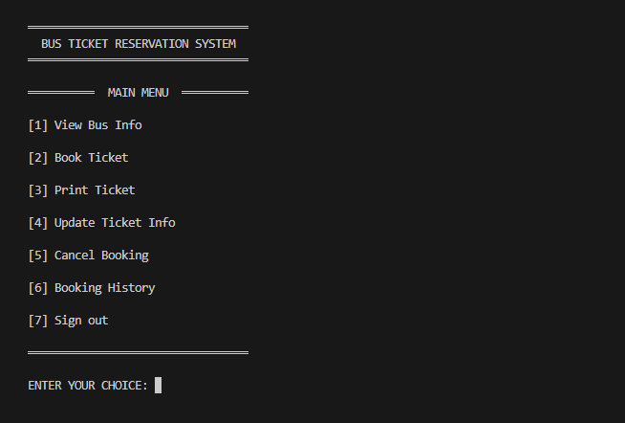
Function Analysis
Main Menu

Slide 9
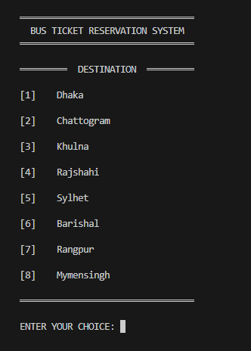
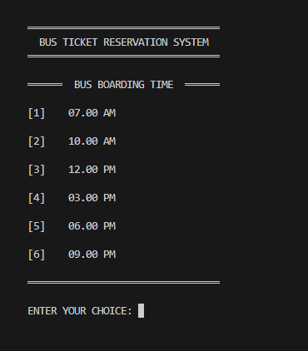
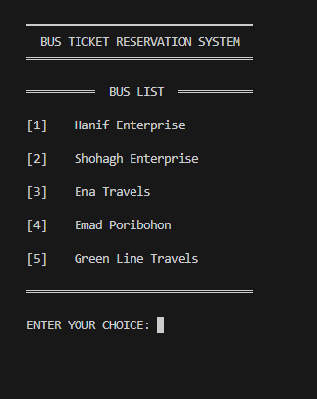
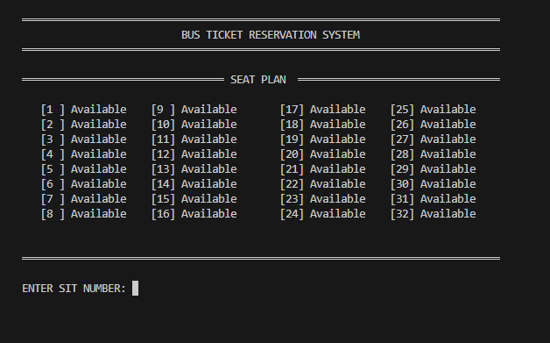
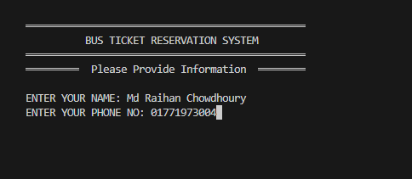
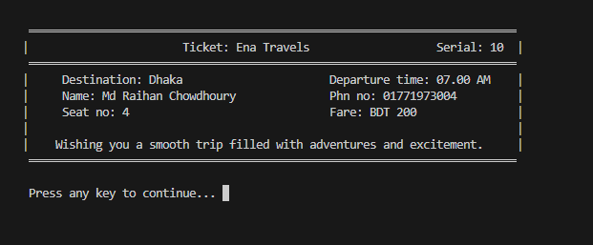
Book A Ticket
1
2
3
4
5
6

Slide 10
Cancel Ticket
1
2
3
4
5
6

Slide 11
System Breakdown
Bus Ticket Reservation System
Signup
Passenger Zone
User Type
Admin Login
Login
Exit
Login
Menu
Menu
View Avaiable bus
Book Ticket
Cancel Ticket
Update Ticket
Print Ticket
Purches History
Sign out
Source code: bit.ly/SE133

Slide 12
Thank you
for your Attention

